Slide 1

Applications of Deep Learning in Smart Transportation Systems
Niharika mullapati

Slide 2
Abstract
World transportation networks encounter major problems due to traffic jams in cities. In the present investigation, "Applications of Deep Learning in Smart Transportation Systems," the usage of Long Short-Term Memory (LSTM) networks and Recurrent Neural Networks (RNNs) for real-time traffic flow prediction is examined. The models were trained and tested with simulated traffic data, and LSTM outperformed RNN in predicting accuracy. The grouping of traffic congestion levels was further confirmed using confusion matrix analysis. The outcomes demonstrate how well deep learning models work to improve adaptive signal control, smart traffic management, and traffic reduction. Future research will concentrate on combining real-time sensor data and solving the issues of cybersecurity, scalability, and productivity in smart transportation systems.

Slide 3
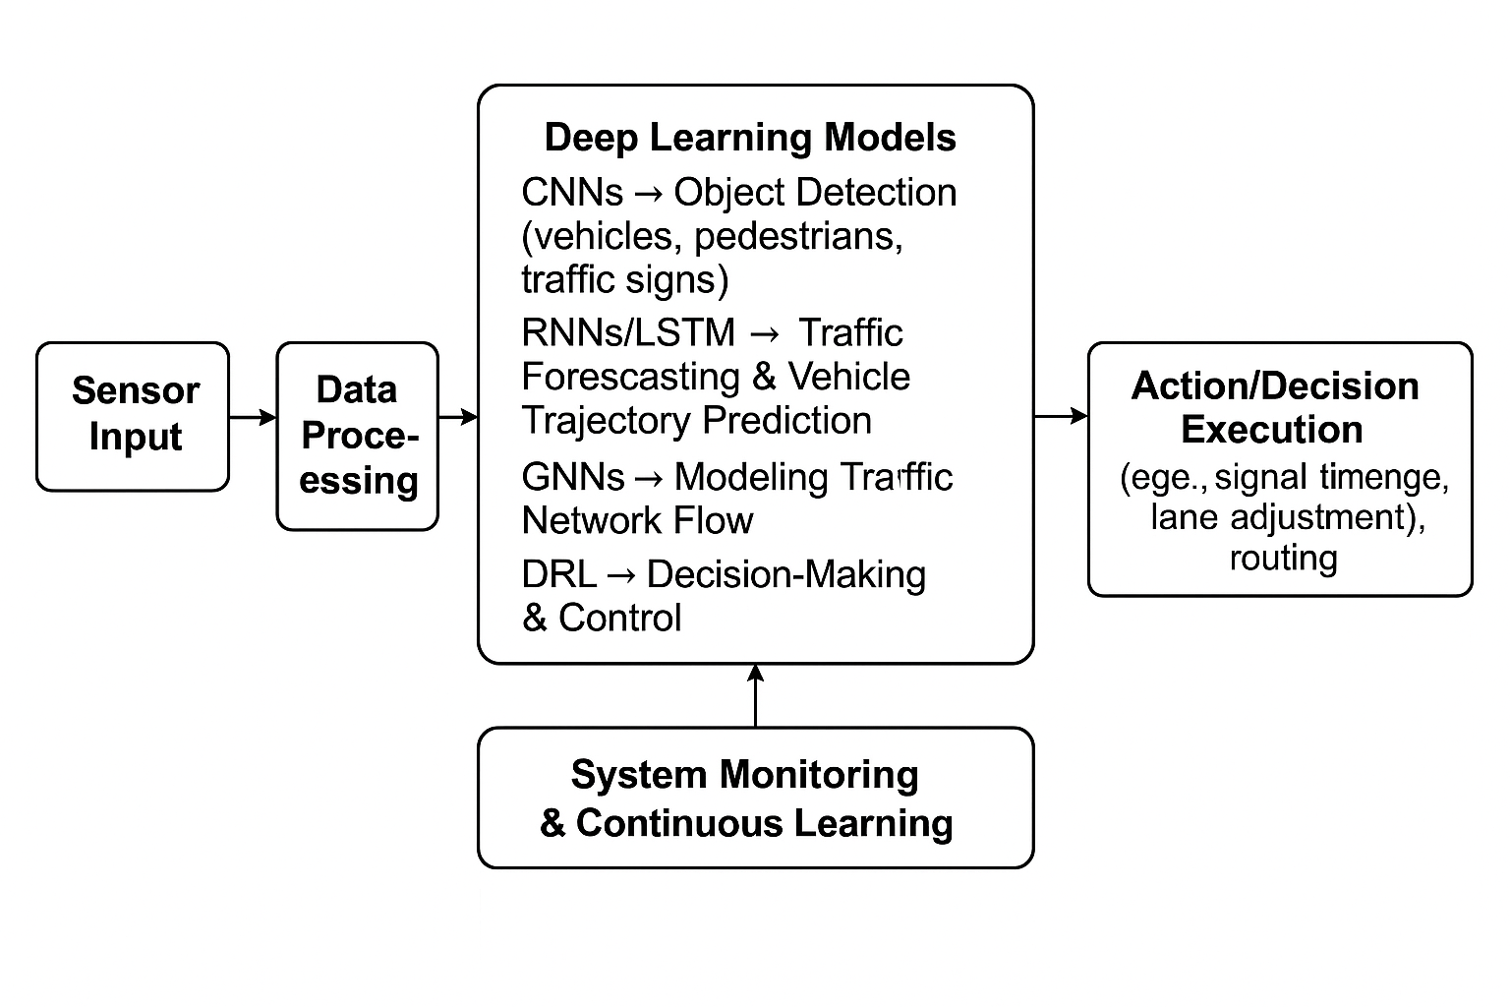
ARCHITECTURE

Slide 4
Sensor Input: Collects traffic data in real time from sensors such as GPS components, radars, and cameras.
Sensor data is cleaned on a regular arranged, and ready for deep learning models through data processing.
Using Deep Learning Models: Uses AI models to identify objects, forecast traffic, simulate network patterns, and arrive at intelligent conclusions.
CNNs → Object Detection: Uses sensor pictures to identify cars, pedestrians, as well as traffic signals.
Using previous information, RNNs/LSTM → Traffic Forecasting: Forecasts future automobile courses and traffic volumes.

Slide 5
GNNs → Traffic Network Traffic Modeling: This approach uses graph structures to model complex traffic patterns throughout a city's road system.
DRL → Decision-Making & Control: Acquires knowledge of the best traffic enforcement methods such as automobile routing and signal timing.
Decision/Action Execution: carries out operations including lane optimization, traffic redirection, and intersection signal changes.
System Monitoring & Continuous Learning: Monitors system performance and keeps modeling updated for better predictions throughout the future

Slide 6
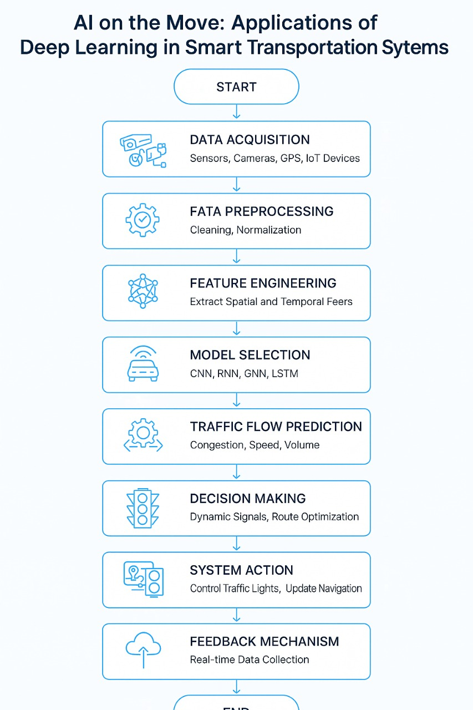
FLOW CHART

Slide 7
The detailed procedure for applying deep learning to intelligent transportation systems
Start The procedure is initiated by the system.
Using sensors, cameras, GPS and IoT devices, gather traffic data in real time using data acquisition.
Preprocessing of Data To prepare the gathered data for modeling, clean and normalize it to eliminate errors.
Identify and extract significant temporal (time-based) and spatial (location-based) features from the data using feature engineering.
Model Selection Select the appropriate deep learning models, such as CNN, RNN, GNN and LSTM, according to the type of data and the requirements for prediction.

Slide 8
Prediction of Traffic Flow :Utilize the chosen models to forecast traffic parameters such as traffic volume, vehicle speed and congestion levels.
Making Choices: Make wise choices, such as modifying traffic signals and recommending alternate routes, based on the forecasts.
System Activity :Control traffic lights and update driver navigation systems to put the decisions into action.
Mechanism of Feedback Continue to gather fresh, real-time traffic data in order to update and enhance the model.
Finish :To continuously improve traffic management over time, the cycle is repeated.

Slide 9
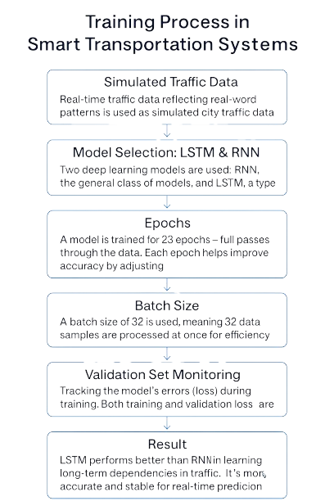
Training process in Smart Transportation System

Slide 10
Data on Simulated Traffic : Since real traffic data is difficult to obtain, we fabricate realistic-looking but fictitious traffic data.
Model Choice: RNN & LSTM : We select two deep learning models that excel at handling time-based (sequential) data: RNN and LSTM.
Time Periods :A total of 23 rounds (epochs) are used to train the model. The model learns better patterns with each iteration.
Batch Size We send the data to the model in small groups of 32 samples at a time rather than all at once. Learning is accelerated and stabilized as a result.
Monitoring Validation Sets : In order to assess the model's performance and ensure that it is more than just memorization, we test it on fresh data (validation set) after every round.
Because the LSTM model is better at remembering long-term patterns, it outperforms the RNN in real-time traffic prediction.

Slide 11
EPOCHS
TRAINED OVER 23 EPOCHS TO IMPROVE PREDICTION ACCURACY.
STRIKES A BALANCE BETWEEN SUFFICIENT LEARNING AND AVOIDING OVERFITTING.
ADDITIONAL EPOCHS CAN BE USED IF THE MODEL DOESN’T CONVERGE..
2. BATCH SIZE:
A BATCH SIZE OF 23 ENSURES FREQUENT UPDATES TO MODEL WEIGHTS.
3. VALIDATION DATA:
CHOSEN BASED ON MEMORY, PROCESSING SPEED, AND PERFORMANCE.
SEPARATE DATA USED TO MONITOR PERFORMANCE AFTER EACH EPOCH.
SEPARATE DATA USED TO MONITOR PERFORMANCE AFTER EACH EPOCH.
TRACKS VALIDATION LOSS TO FINE-TUNE MODEL HYPERPARAMETERS.
Training Process for Traffic Flow Prediction

Slide 12
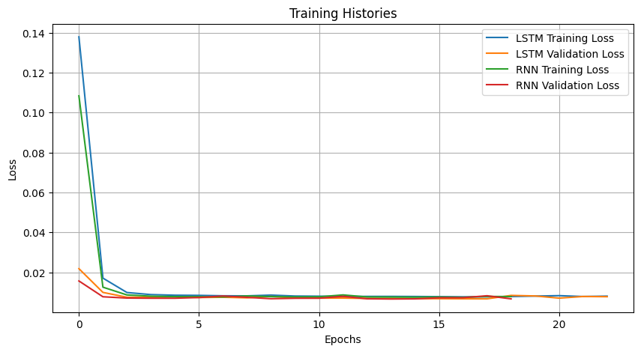
Evaluation Metrics & Visualization of Training History
Fast Convergence: LSTM and RNN models converge quickly within the first few epochs, with a sharp drop in loss after epoch 1.
Low Final Loss Values: After convergence, training and validation losses for both models remain consistently low (~0.01), indicating stable learning and minimal overfitting.
LSTM Slightly Outperforms RNN: LSTM maintains marginally lower training and validation losses than RNN, suggesting slightly better performance.
Consistent Validation Behavior: No major divergence between training and validation losses, showing good generalization for both models.

Slide 13
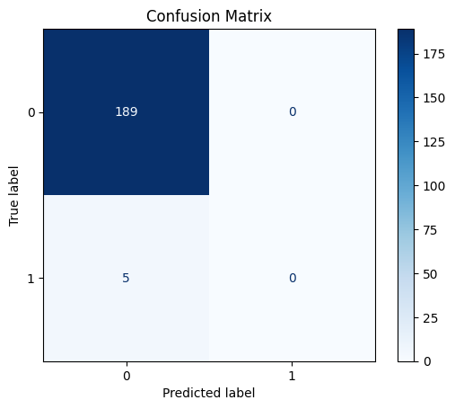
Analysis of Confusion Matrix(LSTM)
High Accuracy for Class 0:The model correctly classified all 189 instances of class 0, showing strong performance on the majority class.
No Correct Predictions for Class 1:All 5 instances of class 1 were misclassified as class 0, indicating the model fails to recognize the minority class.
Class Imbalance Issue: The dataset appears imbalanced, with far more examples of class 0 than class 1, potentially leading to biased predictions.
Need for Improvement on Minority Class: Techniques like resampling, adjusting class weights, or using different evaluation metrics (e.g., F1 score) may help address this issue.

Slide 14
Analysis of Confusion Matrix(RNN)
Perfect Classification for Class 0:All 189 samples of class 0 were correctly predicted.
Class 1 Completely Misclassified: All 5 class 1 instances were misclassified as class 0.
Indication of Class Imbalance: The model is heavily biased toward the majority class (class 0).
Needs Improvement on Minority Class: Suggest using techniques like oversampling, class weights, or advanced models to improve recall for class 1.

Slide 15
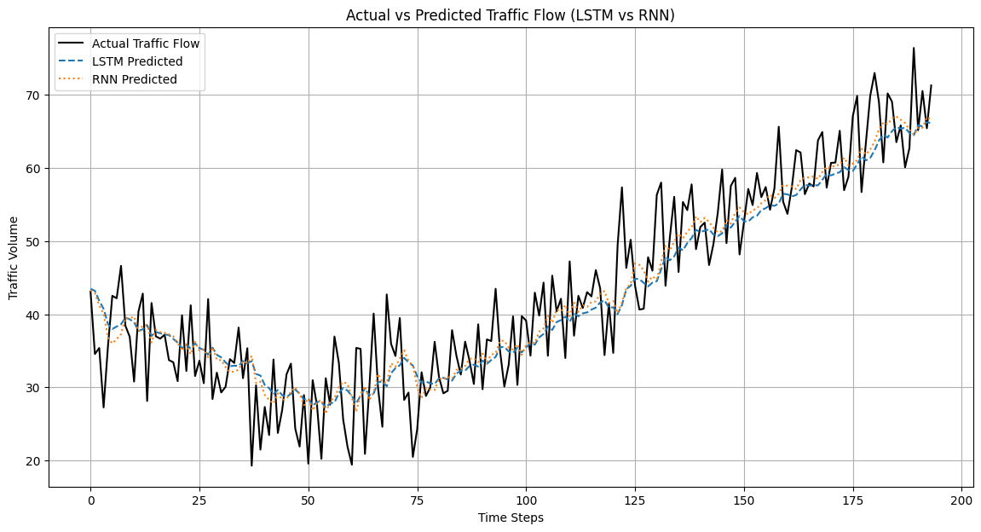
LSTM and RNN Model Predictions of Traffic Flow:
LSTM accuracy: LSTM predictions closely match actual traffic, showing superior learning.
RNN deviations: RNN struggles with traffic changes, showing less accurate predictions.
Upward trend: Both models capture the general increase in traffic over time.
LSTM favored: Visuals clearly show LSTM's better performance in this forecast.

Slide 16
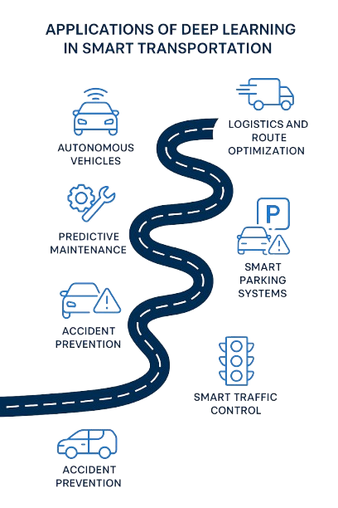
APPLICATIONS

Slide 17
CHALLENGES
Data Quality
Model Interpretability
Environmental
Sustainablity
Real–Time Consuming
Cybersecurity
Scalability &Deployment
Lack of clean, real-time traffic data affects model accuracy
Deep learning models are often black boxes, hard to explain
Low-latency response is needed for effective traffic decisions
AI systems are vulnerable to attacks on data and infrastructure
Training large models consumes a lot of energy
Difficult to apply models city-wide due to cost and complexity.

Slide 18
future recommendations
Autonomous Vehicle Coordination
Smart Parking Systems
Multimodal Sensor Fusion
Accident Detection and Prevention
Edge AI for Real-Time Decision-Making
Environmental Impact Reduction

Slide 19
conclusion
Deep learning has the potential to significantly enhance traffic systems, particularly with models like LSTM and RNN. These models forecast traffic flow, optimize signal control, and lessen accidents and congestion by utilizing time-series prediction. The LSTM model outperformed the RNN in this study, demonstrating its ability to handle intricate, real-time traffic data. Even though the outcomes are encouraging, issues like cybersecurity, real-time processing, data quality, and model transparency still need to be resolved. All things considered, this project lays a solid basis for creating smart, safe, and efficient transportation systems, which will increase the responsiveness and sustainability of our cities.

